Slide 1



Analyzing Agricultural productivity
Across Indian states

Slide 2

Learning Objectives
1.Understanding Regional Differences
2.Identifying Key Influencing Factors
3.Interpreting Data Trends
4.Evaluating Policy Impacts
5.Drawing Actionable Insights
GOAL
Source :
www.freepik.com/

Slide 3
Tools and Technology used
Power BI is a powerful business intelligence (BI) tool used for:
Data Visualization – Creating interactive dashboards and reports.
Data Integration – Connecting to various data sources like Excel, SQL, APIs, and cloud services.
Data Analysis – Using formulas (DAX) and AI features to extract insights.
Real-time Monitoring – Streaming live data from IoT sensors, financial systems, or operational sources.

Slide 4
Methodology
For analyzing agricultural productivity across Indian states using Power BI, a structured methodology ensures accurate insights and meaningful visualizations. Here's a step-by-step approach:
Defining Objectives
Data Collection & Preparation
Data Modeling & Transformation
Data Visualization in Power BI
Predictive Analytics & AI Integration
Insights & Recommendations
Reporting & Sharing

Slide 5
Problem Statement:
Agriculture is a vital sector for India’s economy, employing a significant portion of the population. However, agricultural productivity varies widely across different states due to factors such as climate, soil quality, irrigation facilities, technological adoption, and government policies. Despite the availability of extensive agricultural data, stakeholders often struggle to derive actionable insights for improving productivity and sustainability.
This project aims to analyze agricultural productivity across Indian states using Power BI by leveraging interactive data visualization and analytics. The goal is to identify regional disparities, key influencing factors, and trends over time. Through data-driven insights, the project will help policymakers, researchers, and farmers understand productivity patterns and formulate strategies for enhancement.

Slide 6
Solution:
By leveraging the capabilities of Power BI, this project provides a comprehensive, data-driven approach to understanding and improving agricultural productivity across Indian states. The insights generated can empower policymakers, researchers, and farmers to make informed decisions that contribute to agricultural growth and sustainability.

Slide 7
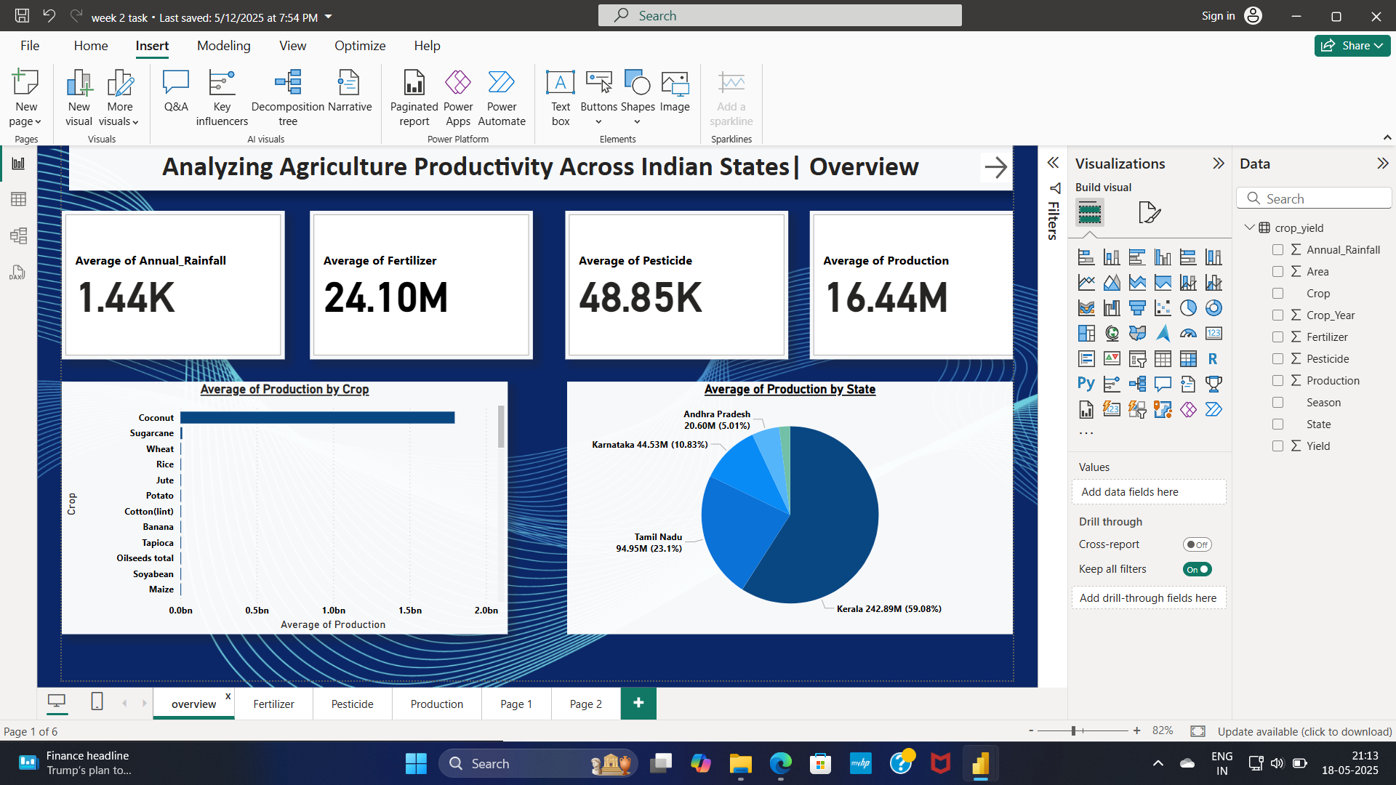
Screenshot of Output:

Slide 8
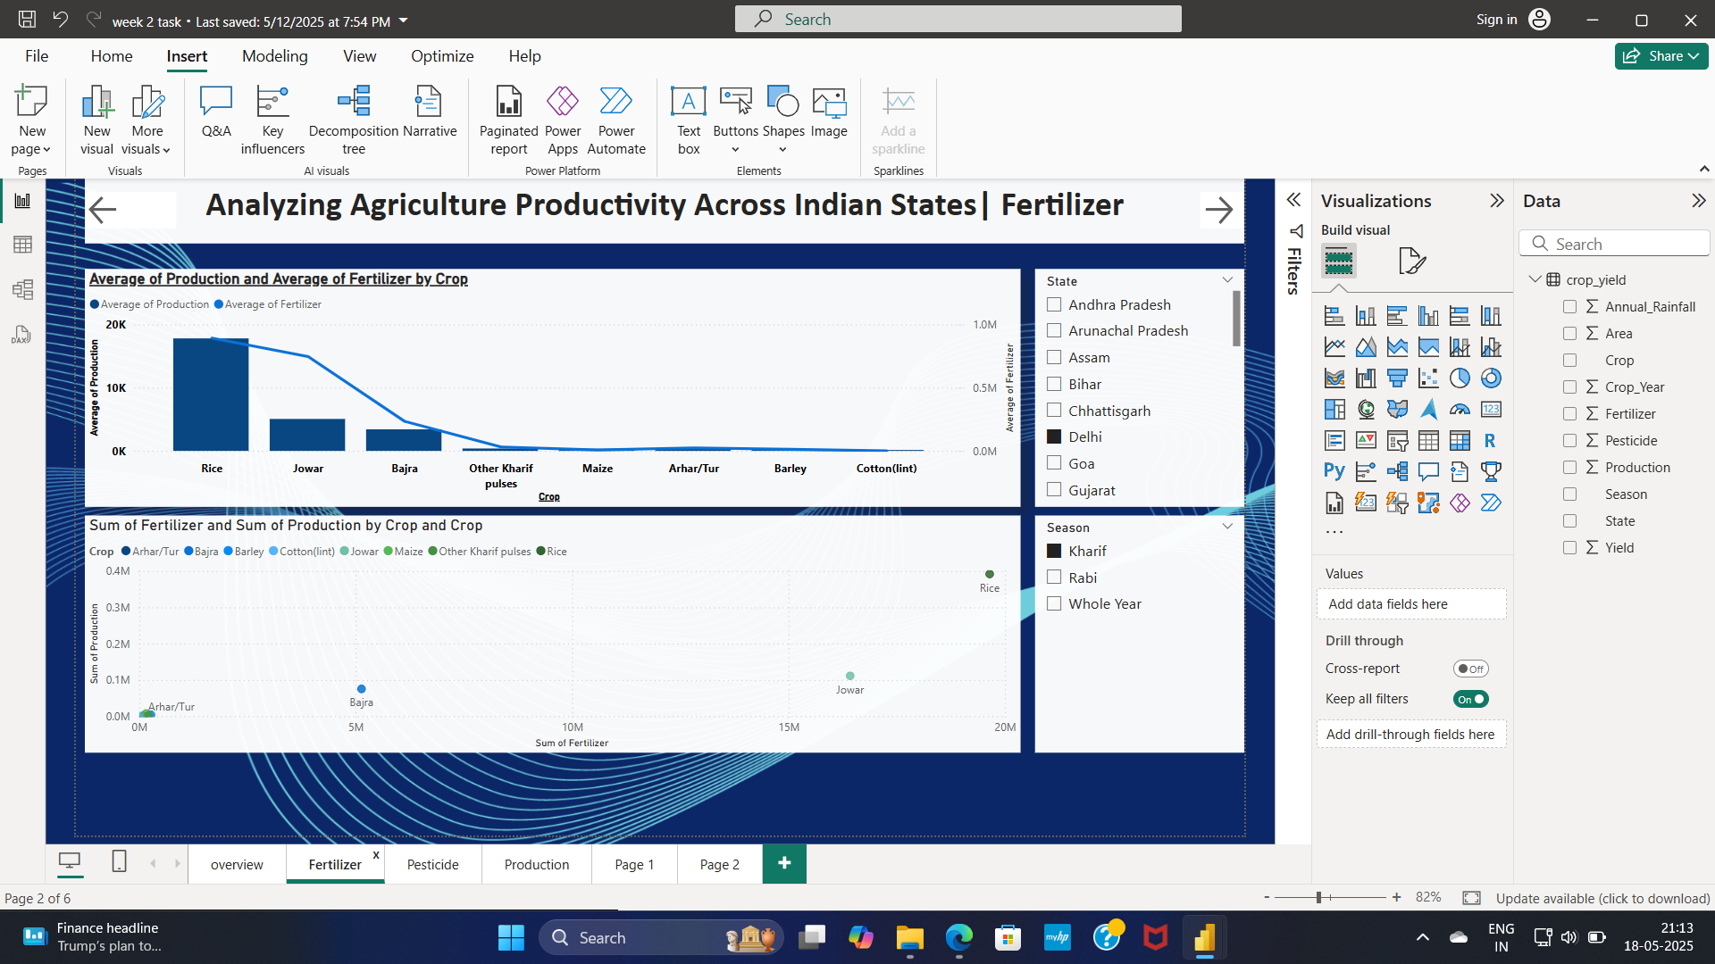
Screenshot of Output:

Slide 9
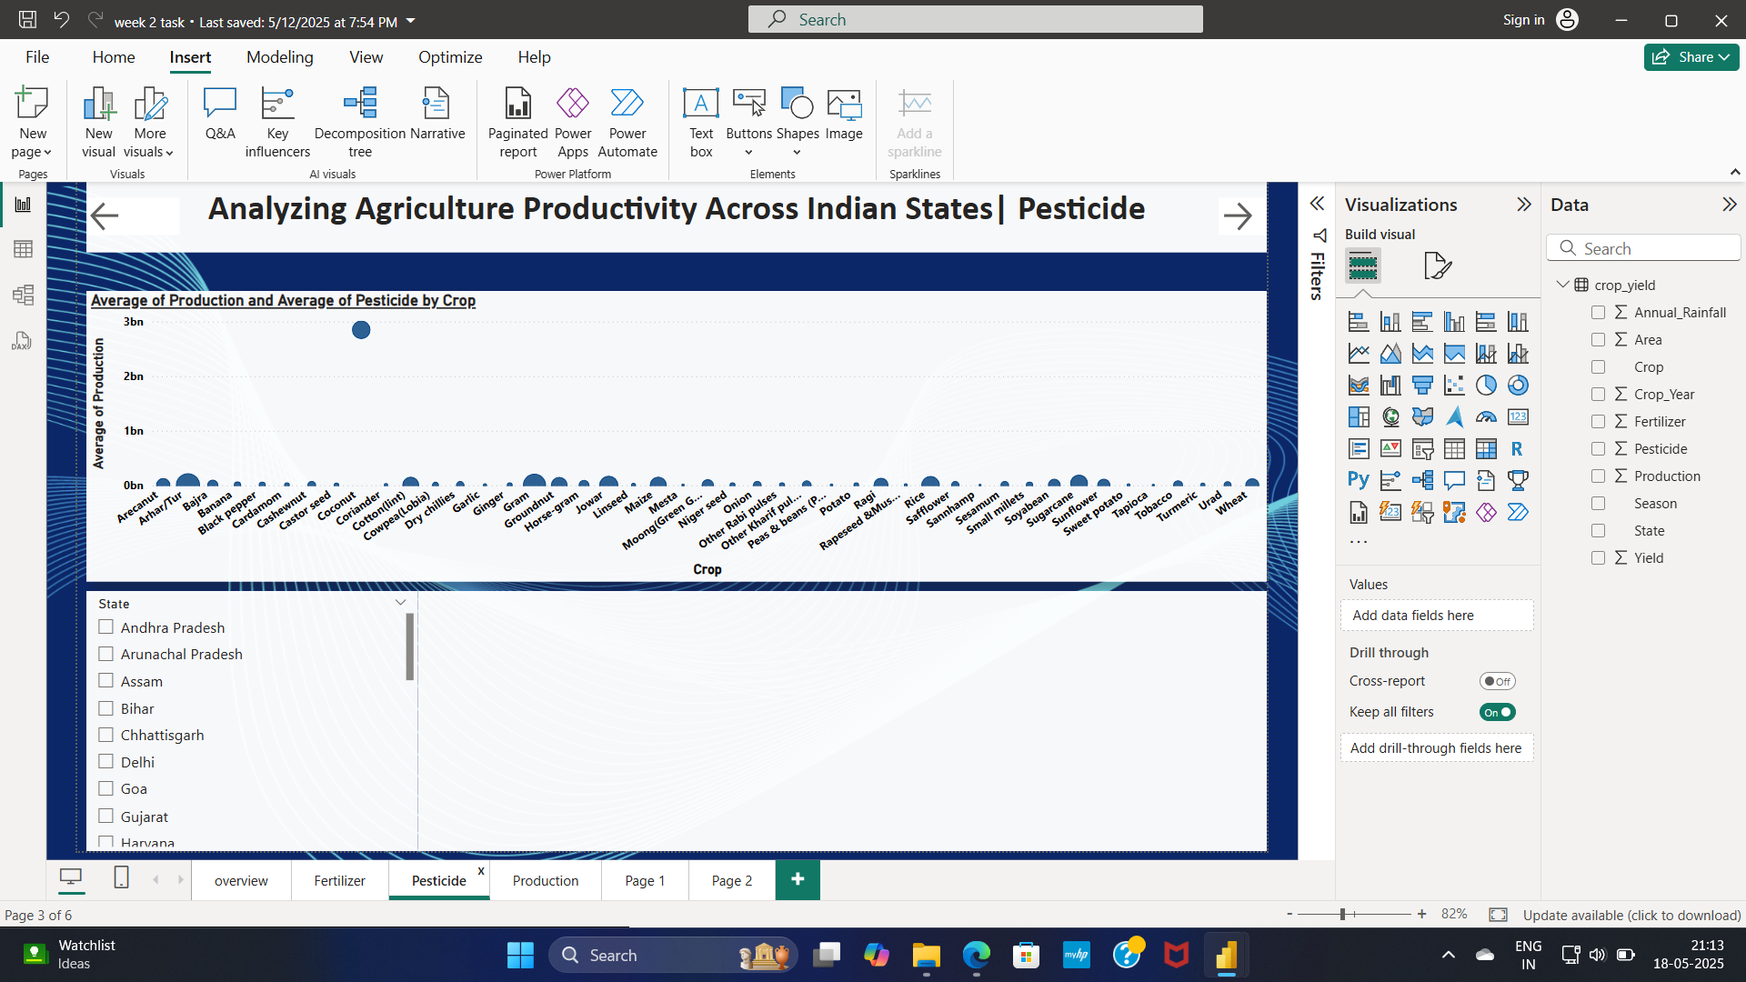
Screenshot of Output:

Slide 10
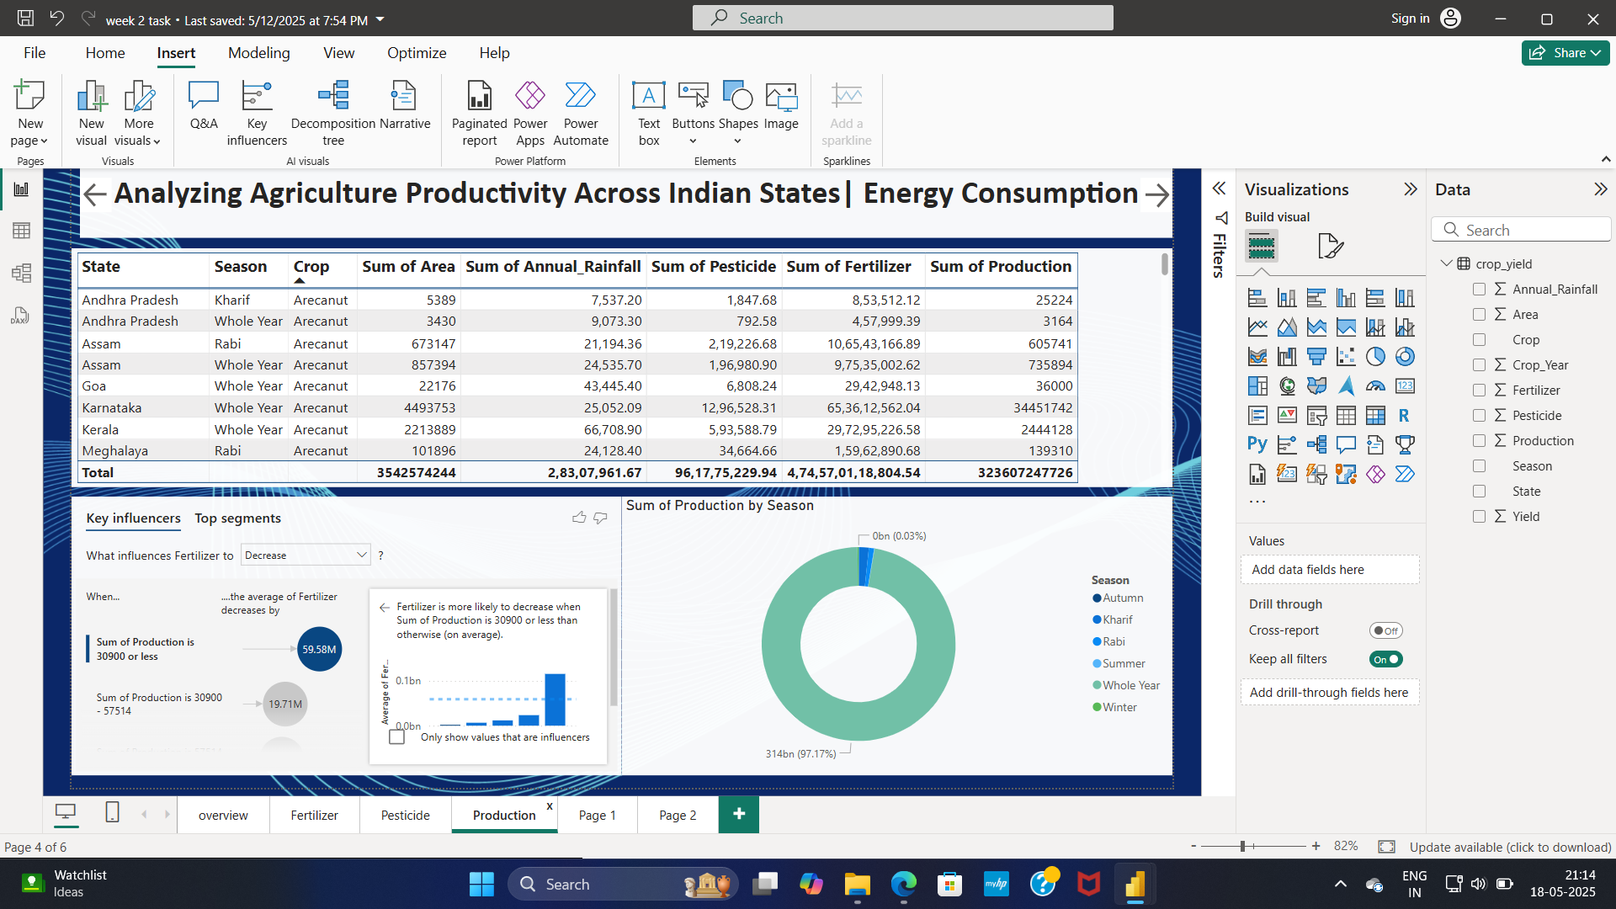
Screenshot of Output:

Slide 11
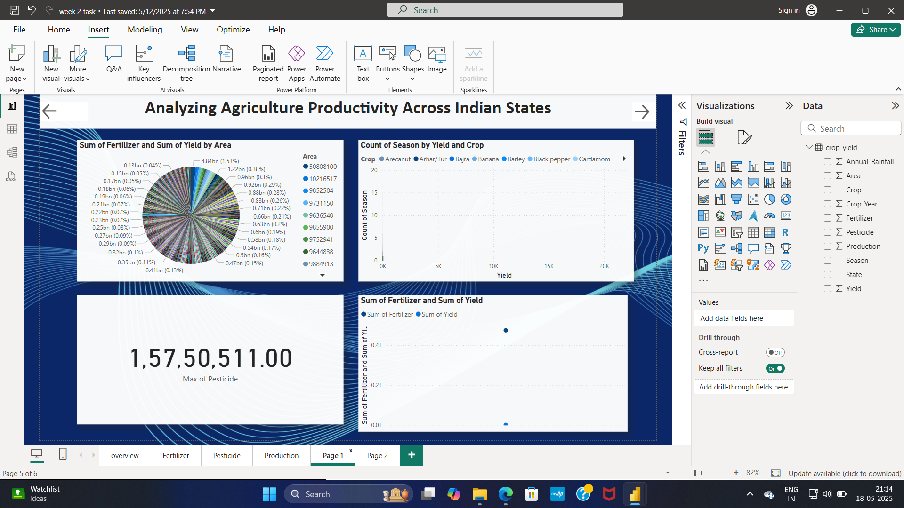
Screenshot of Output:

Slide 12
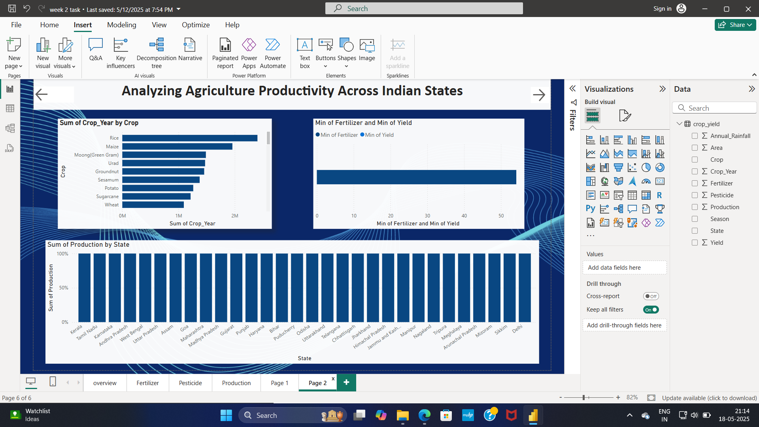
Screenshot of Output:

Slide 13
Conclusion:
The analysis of agricultural productivity across Indian states using Power BI provides valuable insights into regional variations, key influencing factors, and potential areas for improvement. By leveraging data visualization, predictive analytics, and interactive dashboards, stakeholders can make data-driven decisions to enhance productivity, sustainability, and economic impact.

